Slide 1

Project Title – Seasonal Agriculture Performance Analysis
[Sarthak Singh Tomar
Madhav Institute of Technology & Science]
AICTE STU ID : (STU6a3910da1bf8f1782124762)

Slide 2

PROBLEM STATEMENT
(Agricultural activities are influenced by seasonal variations in environmental conditions, farming practices, resource availability and market conditions. As a result, agricultural performance may differ from one season to another. However, raw agricultural data does not clearly explain how agricultural performance changes across seasons or what patterns can be observed in different seasonal conditions. The problem is to analyze the given agricultural dataset and investigate seasonal differences in agricultural performance by identifying meaningful patterns, trends, relationships and variations within the available data.

Slide 3
Project Description
Seasonal Agriculture Performance Analysis studies agricultural data across different seasons to identify trends, variations, and relationships in crop production, resource usage, environmental conditions, and economic performance. The project uses data analytics and visualization to generate insights and support better agricultural planning.

Slide 4

WHO ARE THE END USERS?
Farmers – to understand seasonal crop and resource patterns.
Agricultural planners – to support seasonal agricultural planning.
Agricultural researchers – to study trends and relationships in agricultural data.
Government/agriculture departments – to support evidence-based decisions.
Data analysts – to analyze and interpret agricultural performance data.

Slide 5

Technology Used
Python – Data analysis and processing
Pandas & NumPy – Data cleaning and manipulation
Matplotlib & Seaborn – Data visualization
Jupyter Notebook – Project development and documentation
Statistical Analysis – Identifying trends and relationships

Slide 6
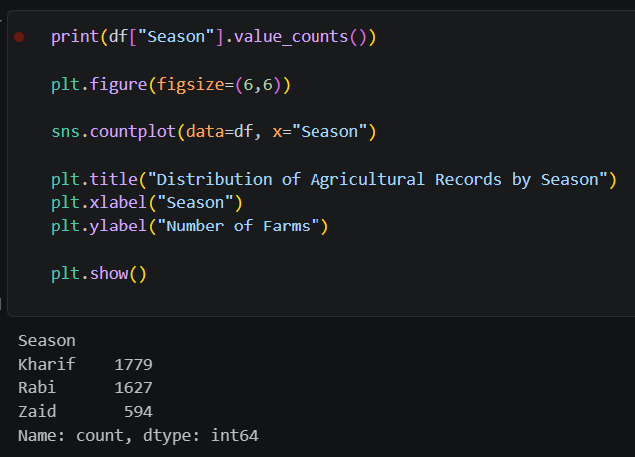
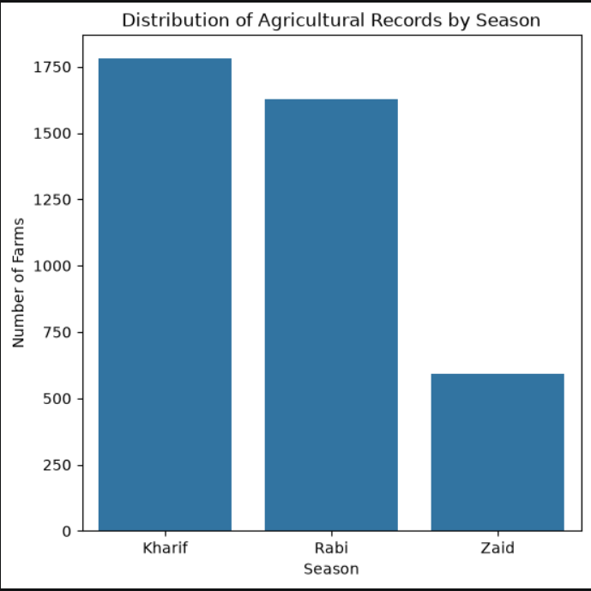
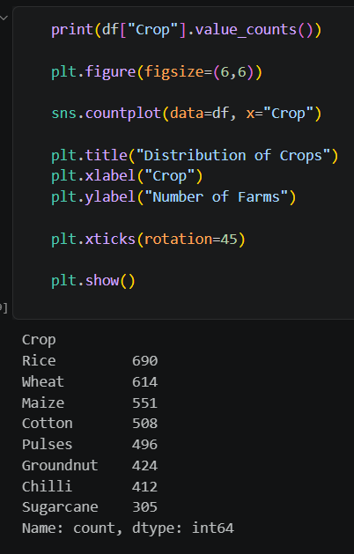
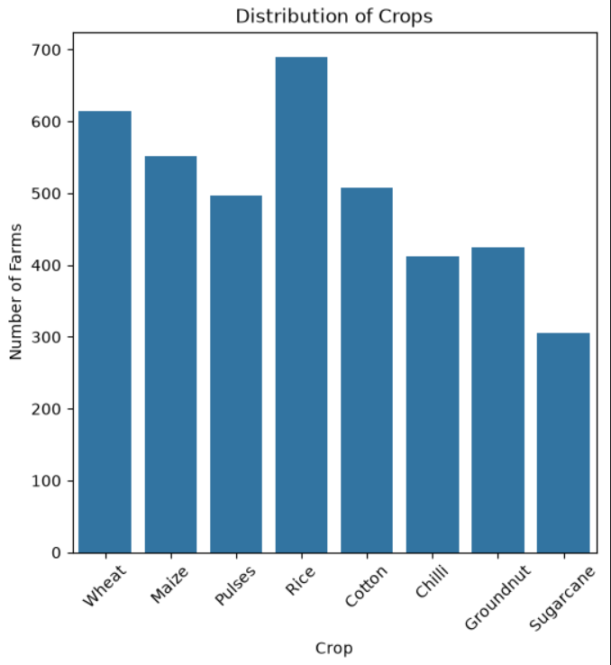
RESULTS

Slide 7
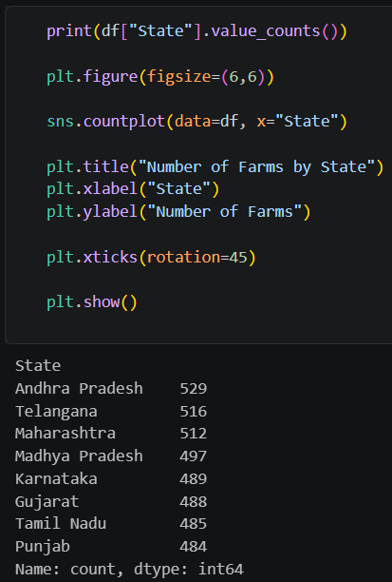
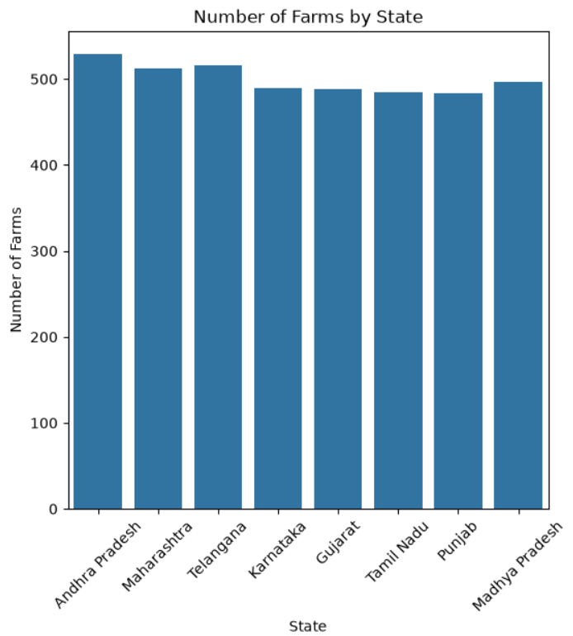
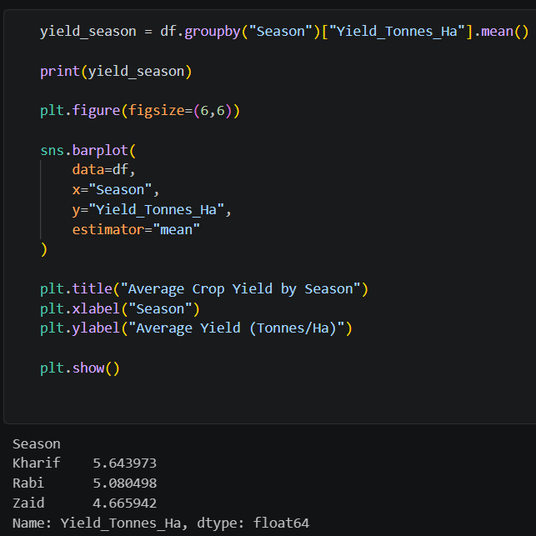
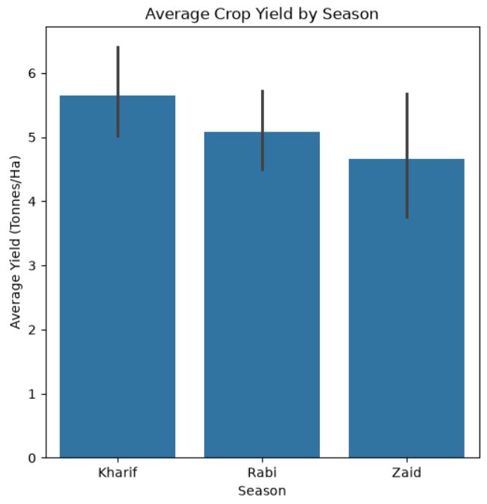
RESULTS

Slide 8
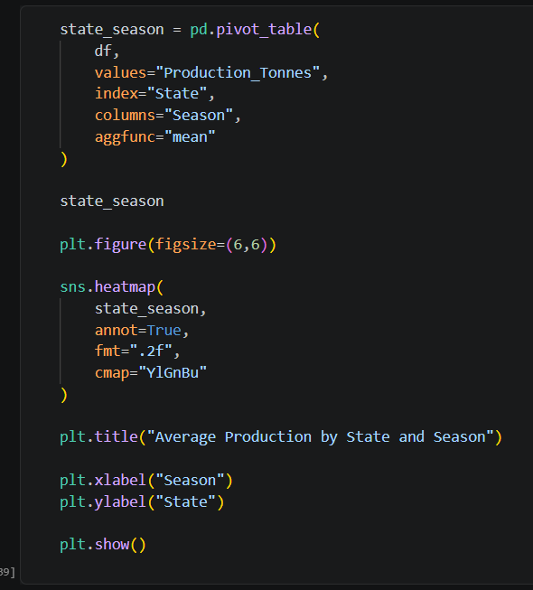
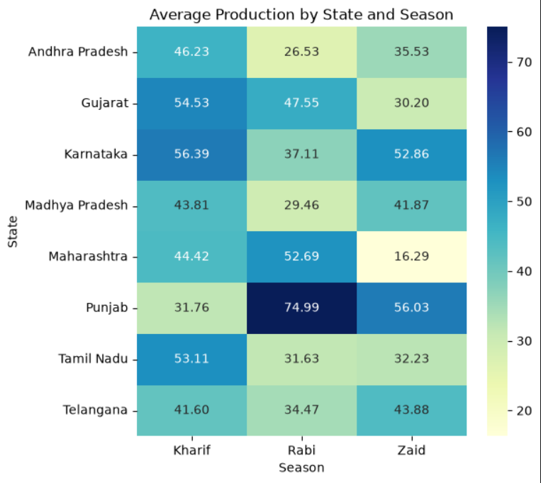
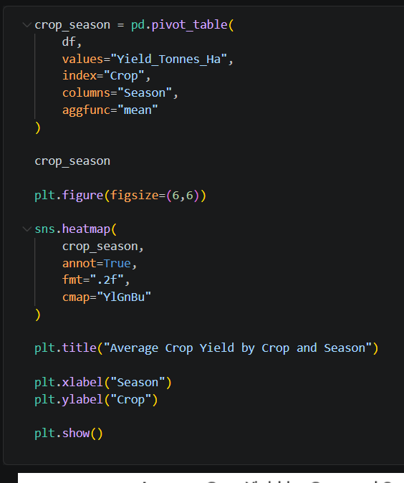
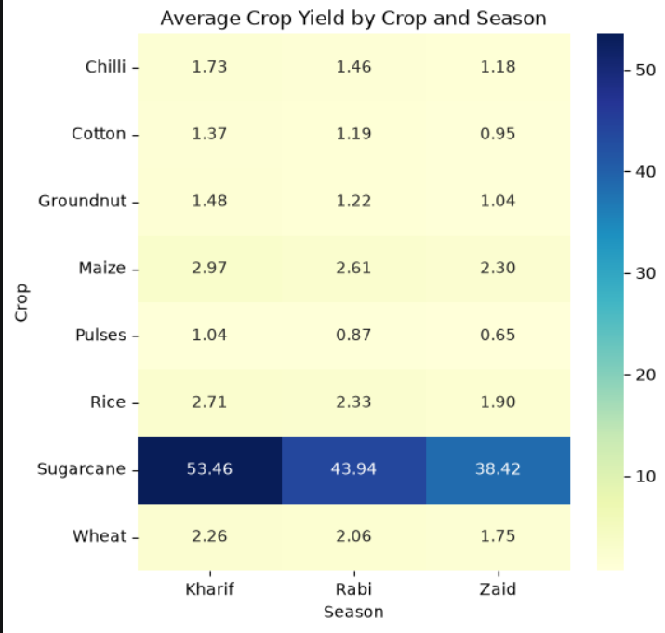
RESULTS

Slide 9
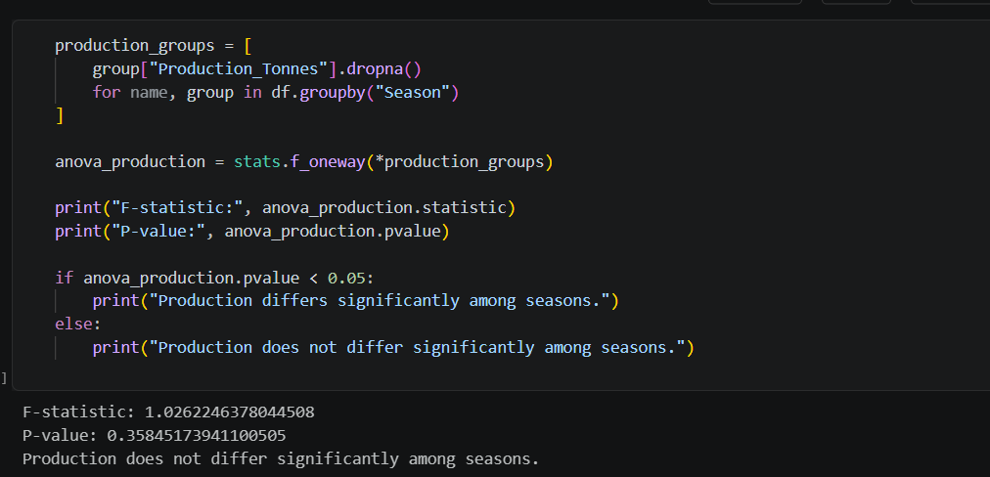
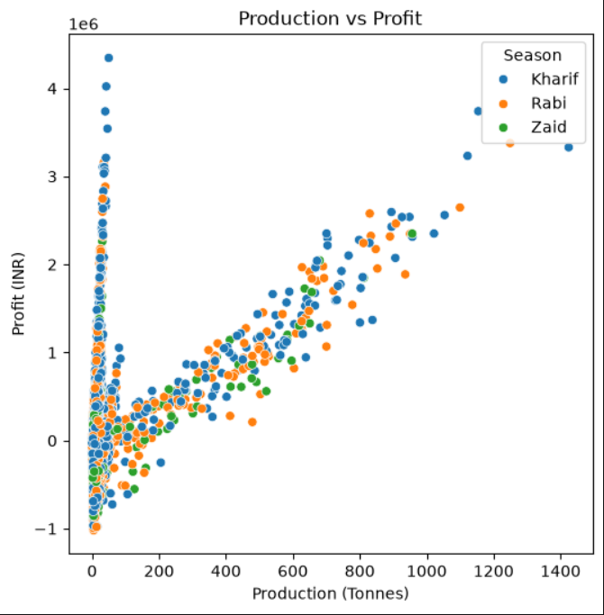
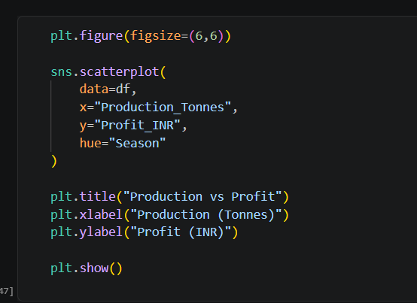
RESULTS

Slide 10
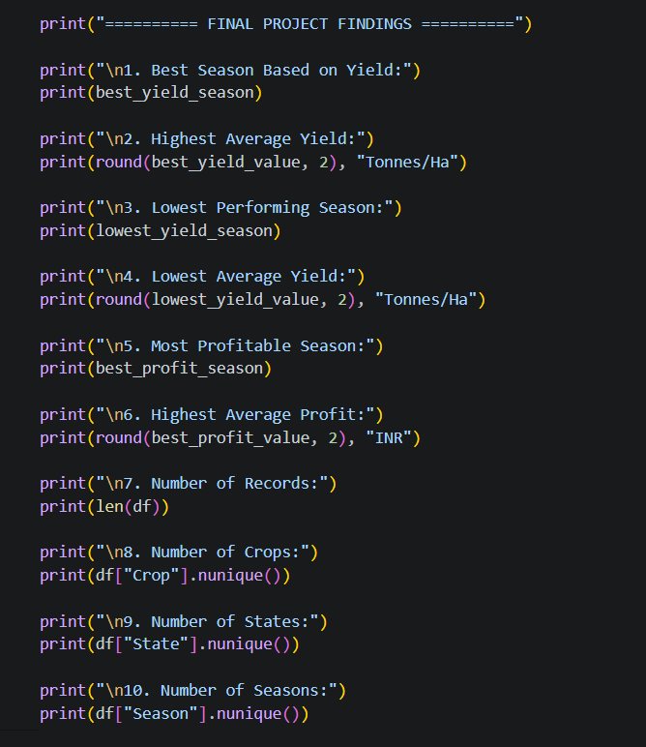
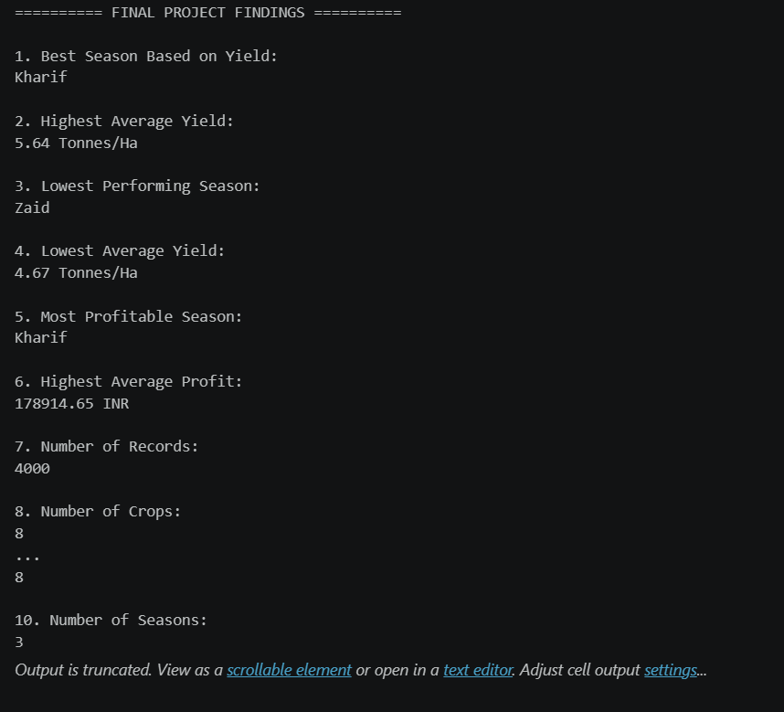
RESULTS
And More…..

Slide 11
Future scope
Develop predictive models to forecast seasonal agricultural performance.
Use real-time weather and environmental data for better analysis.
Build an interactive dashboard for farmers and agricultural planners.
Expand the analysis to include more regions, crops, and seasons.
Use advanced analytics to provide data-driven recommendations for crop planning.

Slide 12
GitHub Link
https://github.com/SarthakTomar2008/Sarthak-Repository

Slide 13
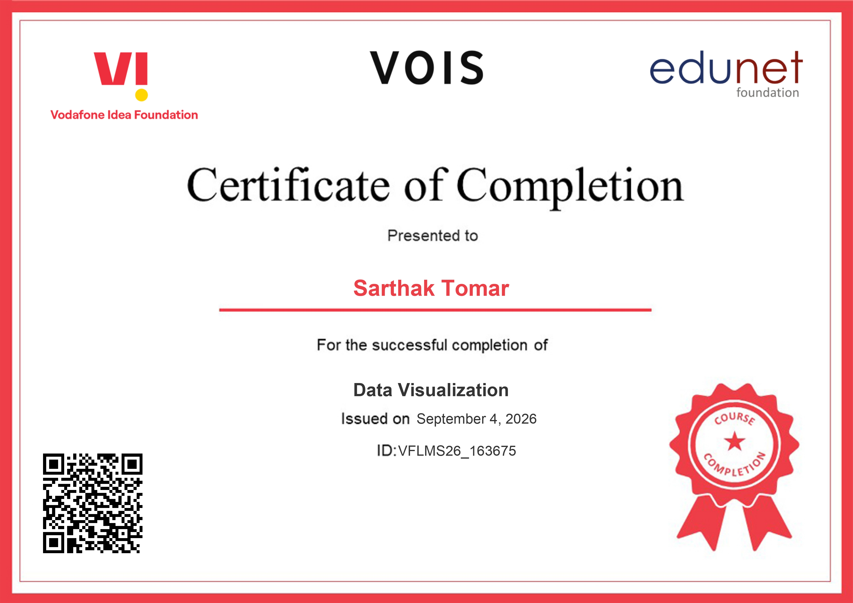
VOIS Course completion certificate -
Course name- Data Visualization

Slide 14
Thank you
.
.

